Slide 1


Slide 2

Topics
What is Web identity Federation
Amazon Cognito
Amazon Cognito - User pools
Amazon Cognito - Identity Pools
Cognito – How it works
Amazon Cognito - Synchronization
Exam Tips

Slide 3
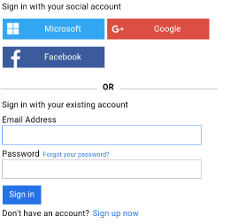
What is Web identity Federation
Web identity Federation lets you give your users access to AWS resources after they are successfully authenticated with a web-based identity provider like Amazon Facebook or Google.
Following the successful authentication, the user receives an authentication code from the Web ID provider, which they can trade for temporary AWS security credentials.

Slide 4

Amazon Cognito
Amazon Cognito provides authentication, authorization, and user management for your web and mobile apps. Your users can sign in directly with a username and password, or through a third party such as Facebook, Amazon, Google or Apple

Slide 5

Amazon Cognito
Amazon Cognito provides Web Identity Federation with the following features:
Sign up and Sign into your apps
Access for guests' users.
Acts as an identity broker between your application and your Web ID providers, so you don't need to write any additional code
Synchronized user data for multiple devices
Recommended for all mobile application AWS services.

Slide 6
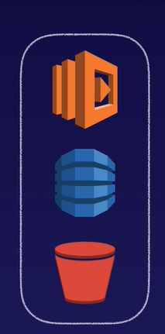




Amazon Cognito
The Recommended approach for Web identity Federation using social media accounts like Facebook.

Slide 7

Amazon Cognito
Cognito brokers between the app and Facebook or Google to provide temporary credentials which map to an IAM role allowing access to the required resources.
No need for the application to embed or store AWS credentials locally on the device and it gives users a seamless experience across all mobile devices.

Slide 8
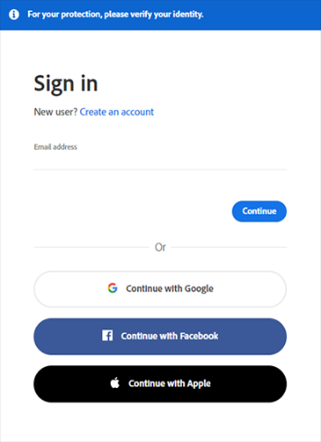
Amazon Cognito - User pools
User pools are user directories used to manage sign-up and sign-in functionality for mobile and web applications.
Users can sign-in directly to the User Pools, or using Facebook, Amazon or Google.
Cognito act as an identity broker between the identity provider and AWS. Successful authentication generates a JSON Web Token (JWT).

Slide 9
Amazon Cognito - Identity Pools
Identity pools are enabled to provide temporary AWS credentials to access AWS services like S3 or dynamo-database
It provide access to AWS resources.

Slide 10
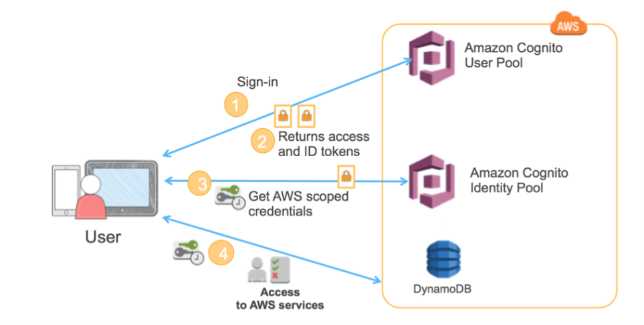
Cognito – How it works

Slide 11
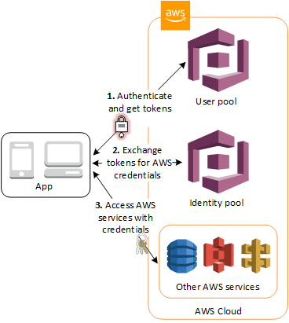
Cognito – How it works

Slide 12

Amazon Cognito - Synchronization
Cognito Synchronization the association between user identity and the various devices that they sign-in from. In order to provide a seamless user experience for your application, Cognitive uses push synchronization to push updates and synchronize user data across multiple devices. Cognitive uses SNS to send a notification to all the devices associated with a given user identity whenever data stored in the cloud changes

Slide 13
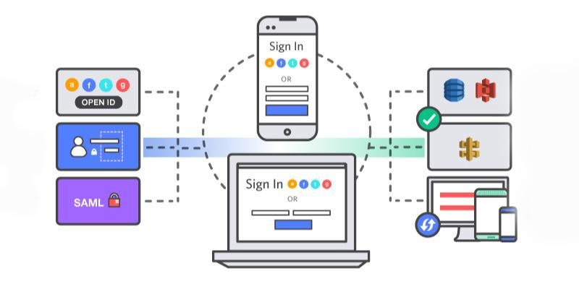
Amazon Cognito - Synchronization

Slide 14
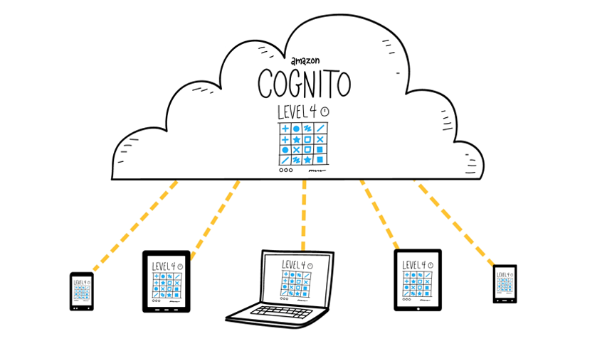
Amazon Cognito - Synchronization

Slide 15
Exam Tip
Federation allows users to authenticate with a web identity provider (Google, Facebook or Amazon)
The user authenticates first with the Web ID provider and receives an authentication token, which is exchange for temporary AWS credentials allowing them to assume IAM role.
Cognito is an Identity broker which handles the interaction between your application and the Web ID provider(You don't need write your own code to do this)
User pool is user based. It handles things like user registration, authentication and account recovery.
Identity pool authorizes access to your AWS resources.

Slide 16
Thank you

